Slide 1
Dancing Links Algorithm
Colton Smith – lilcoltsmith@gmail.com
CS 315 Honors – Algorithms
Department of Computer Science
University of Kentucky
December 17, 2015

Slide 2
Abstract
The Dancing Links algorithm is an efficient implementation of the ideas explained in Knuth’s Algorithm X. This algorithm is applied to problems known as Exact Cover problems, in which we try to find a way to cover a board to meet specifications. The Dancing Links Algorithm is a recursive, nondeterministic, depth-first, backtracking algorithm. In other words, it is used to solve those pesky NP-Complete problems.

Slide 3
Problem Statement
Solving a Sudoku seems like a relatively easy concept, does it not? One could simply go through each square and try every possible combination. The problem here is that would be totally inefficient, given that there are 6,670,903,752,021,072,936,960 total combinations for a standard Sudoku grid. While this is significantly less when you are given numbers, it is still way too many combinations to search through. Using the Dancing Links Algorithm, along side a smart auto complete algorithm, it is possible to solve puzzles in a matter of seconds.

Slide 4
Importance
Knuth says that most, if not all NP problems can be reduced to some form of Exact Cover problem. If this is the case, then using Dancing Links, we are able to come up with a solution to these problems efficiently. Whether or not they are an optimized solution is another story, but at least a solution can be reached. The three most common examples of problems related to this topic are:
N Queens Problem
Pentomino Tiling
Sudoku
Other possible uses of Dancing Links would be for encryption and decryption.

Slide 5
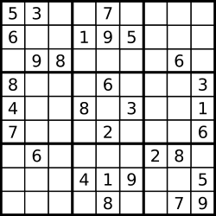
Problem Explained
In case you don’t know what a Sudoku puzzle is, let me explain:
9 x 9 Grid filled with numbers 1 – 9
Each row/column/3 x 3 sub-grid must contain only one of each number between 1 – 9
There are three difficulties: Easy, Medium, and Hard

Slide 6
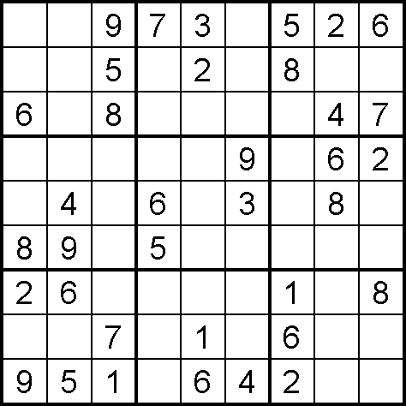
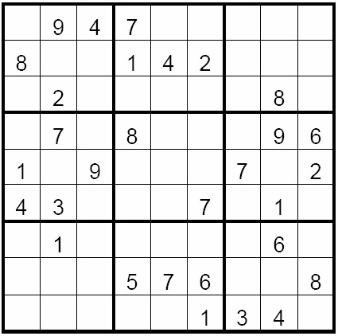
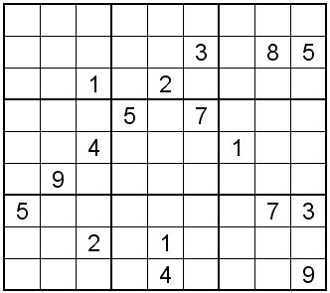
Problem Explained cont.
<- Easy
Medium ->
Hard ->

Slide 7
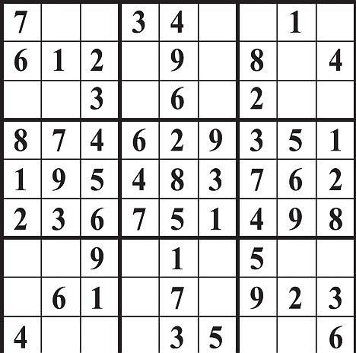
Solutions/Algorithms
In terms of solving Sudoku puzzles, there are three levels of difficulty. The first level contains numbers that are obvious to fill in:
In order to speed up the process of Dancing Links, we need to eliminate these freebies.

Slide 8
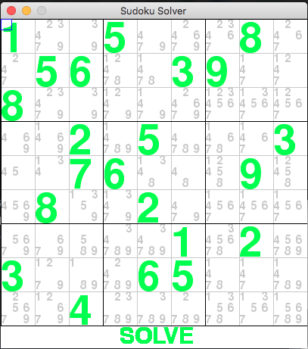
Solutions/Algorithms cont.
The second level of solving the puzzle is by marking down the possibilities of numbers that can go into each cell of the grid. In other words, we have a 3D Array. Here is an example from my implementation:

Slide 9
Solutions/Algorithms cont.
The third and final level is to use assumptions based on numbers written inside cells that are not solved yet to narrow down the possible combinations for a solution. Using Dancing Links, we can go through each cell and recursively try each number until a solution can be found to fit out Exact Cover problem. The good thing is, that some puzzles will indeed have multiple solutions!
2
4
9
7
3

Slide 10
Solutions/Algorithms cont.
Dancing Links is best explained by using a matrix of only 0’s and 1’s. For example, below is a matrix. The solution is found by selecting a subset of rows that allows for one 1 per column. In this case, the rows A and C create a solution:
 | 2 | 3 | 4 | 5 | 6
A | 0 | 1 | 1 | 1 | 0
B | 1 | 1 | 0 | 1 | 1
C | 1 | 0 | 0 | 0 | 1

Slide 11
Run-Time for Different Puzzle Difficulties
Easy | Medium | Hard
.003407 seconds | .070150 seconds | 1.20966 seconds
.004909 seconds | .011032 seconds | .017424 seconds
.004063 seconds | .013887 seconds | .887924 seconds
μ = .004126 seconds | μ = .03169 seconds | μ = .705003 seconds

Slide 12
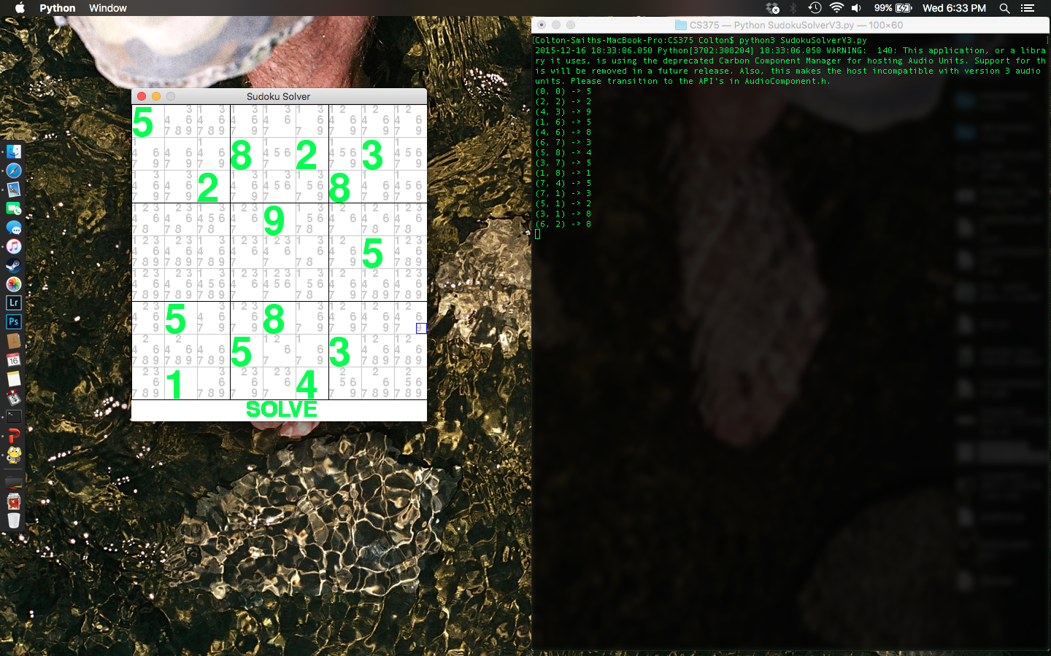
Now I would like to show you an implementation
Place your screenshot here

Slide 13
Conclusion
There is always room to speed up the implementation and do more with the graphical part of the program. For instance, while the puzzle is being solved, show numbers being filled in on the Sudoku Grid. Also, making the solver into a Sudoku game, with the option to solve the puzzle. It would also be interesting to implement a solution for larger Sudoku grids, as 9 x 9 is only the standard size.

Slide 14
Questions?

